Slide 1

Module 11 – Survey Management
Author
Department
Jan 2018
Notes:
[STANDARD SLIDE: L300 (animated)]
You can change out the photo with any image from Getty Images in DropBox.
If the main title is shorter, you can make the font larger.
You may have to move the title text around depending on the photo. Make sure the text is readable against the background photo.
You can change the background color for the rectangle in the bottom-right corner to look better against the background. Choose a Micro Focus color at 25% transparency.
=========================
Note to Narrator or Reader: [PRESS] indicates press the Page Down key to show the animation
=========================
Hello and Welcome to the [COURSE_NAME] Technical Overview Training, Level 300.
In this course you’ll gain a high-level understanding of the essentials of [PRODUCT_NAME].
[PRESS] If you want to download this presentation and save it on your own system, click the Tools & Help icon in the bottom-right corner of your window and select Download.
Or, if you want to access the PPT slides and speaker notes for future reference, go to the Attachments tab in your window click to download the presentation.

Slide 2
Objectives
Describe Survey functionality
Be able to design a new Survey
Understand the different Question/Answer types
Explain how Big Data Analytics allows you to analyze survey results
Be able to send a survey manually
Initiate a Survey using a business rule

Slide 3
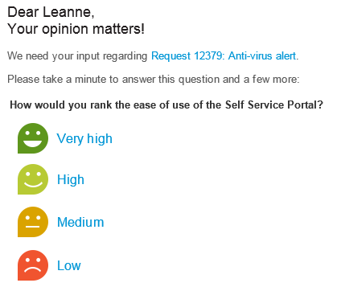
Survey Management
Measure and improve customer satisfaction
Configure & select surveys to be sent to end users.
Easy to set up with friendly formats.
Surveys can be defined for a variety of scenarios:
Satisfaction surveys for Service Support
Post-Change success survey
Application utilization and proposal survey
… and more!
Notes:
Survey Management
Survey management enables you to create surveys to be sent to end users, and to consume the data collected by the surveys.

Slide 4
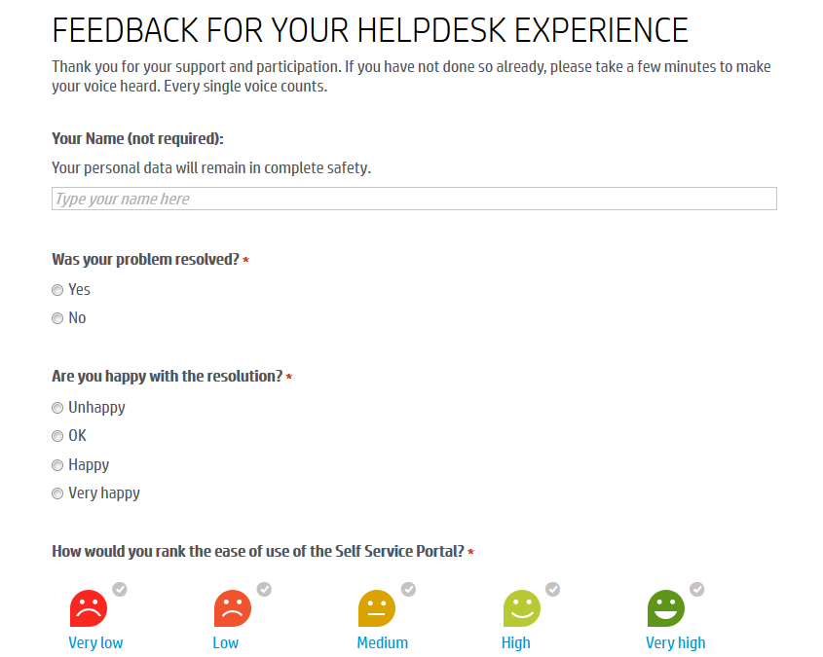
Survey Management – Friendly formats
Title and User instructions
Friendly formats are designed to increase user response rates.
Short text question
Primary survey rating question (this will appear in email to end user)
Radio button questions
Radio button questions

Slide 5
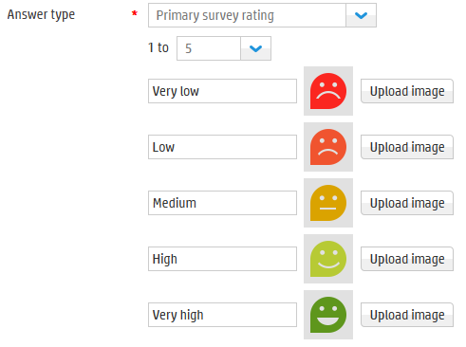
Survey Management – Friendly formats
There are a number of different Answer Types which can be added for a question:
Primary survey rating
Rating
Rating group
Text
Short text
Radio
Number
Notes:
For further information about Answer Types, please refer to the Help Center.

Slide 6
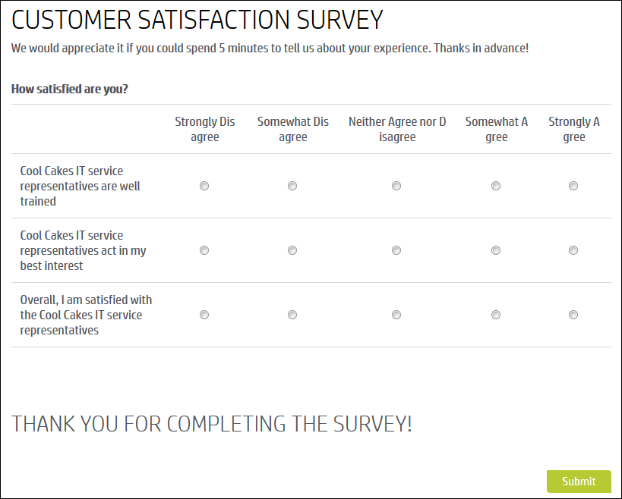
Survey Management – Friendly formats
You can even add a group of questions as a Rating Group.

Slide 7
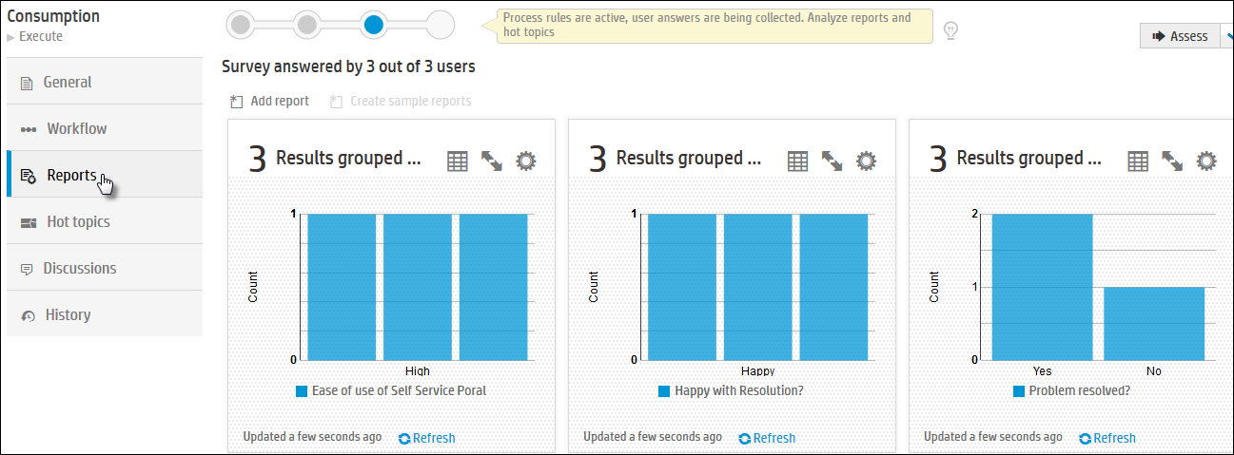
Survey Management – Reporting
Reports can be seen on the Reports tab, or from Reporting application.
Notes:
Hot Topic Analytics for Surveys
Hot Topic Analytics in Survey Management enable you to analyze the answers to text questions in surveys.
You can analyze each text question individually, and filter by the answer time or by specific values related to the primary rating question of a survey.
You can perform hot topic analytics on answers received in the current execution cycle. For example, if a survey is in its second execution cycle but has not yet received answers, you will not be able to search through the results until you receive answers in that cycle.
To analyze a specific topic, click it in the hot topics map. To read the actual response to a survey question, click the result in the displayed list

Slide 8
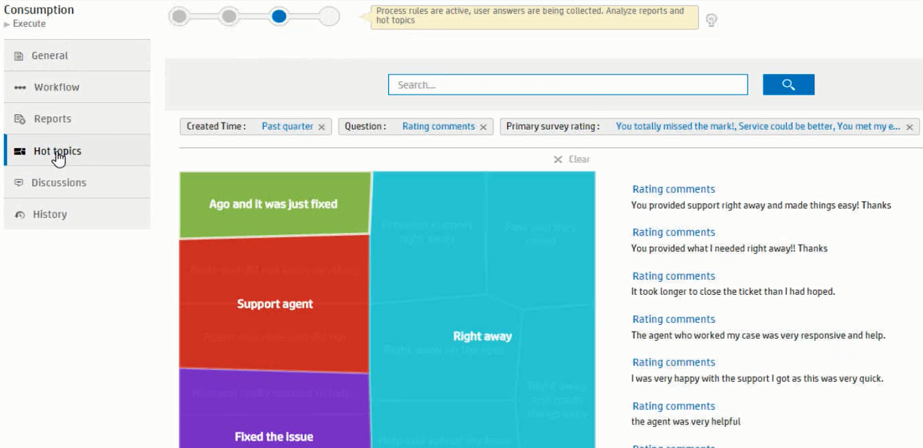
Survey Management – Hot Topic Analytics
Hot topic analytics of responses with full reporting and dashboard widget capabilities.
Notes:
Hot Topic Analytics for Surveys
Hot Topic Analytics in Survey Management enable you to analyze the answers to text questions in surveys.
You can analyze each text question individually, and filter by the answer time or by specific values related to the primary rating question of a survey.
You can perform hot topic analytics on answers received in the current execution cycle. For example, if a survey is in its second execution cycle but has not yet received answers, you will not be able to search through the results until you receive answers in that cycle.
To analyze a specific topic, click it in the hot topics map. To read the actual response to a survey question, click the result in the displayed list

Slide 9
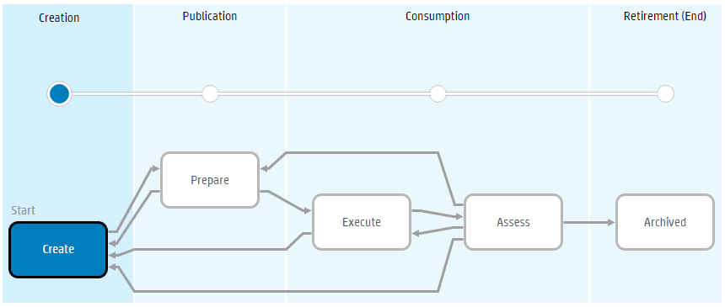
Survey Workflow
Survey is Active and can be used
Notes:
Survey Workflow
Create – The survey is created. Sections are added including structure and questions. Fields are selected which will appear in the survey reports. Note: The survey cannot advance to the Prepare phase until at least one question has been added to the survey.
Prepare – The survey is prepared for execution. The Survey Editor can define execution dates, create business rules for sending the survey, and prepare reports.
Execute – The survey has been sent out and data is being collected. In this phase only, business rules are active and answers are being collected.
Assess – In this phase, no further data is collected. At this point, the Survey Editor can analyze reports and review hot topics.
Archived – The survey is inactive. Execution and review of the survey is complete.

Slide 10
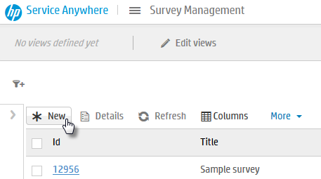
Create a new Survey (1)
Mega menu > Build > Survey
From the Survey List, click New.
Notes:
For further information about creating a new survey, please refer to the Help Center.

Slide 11
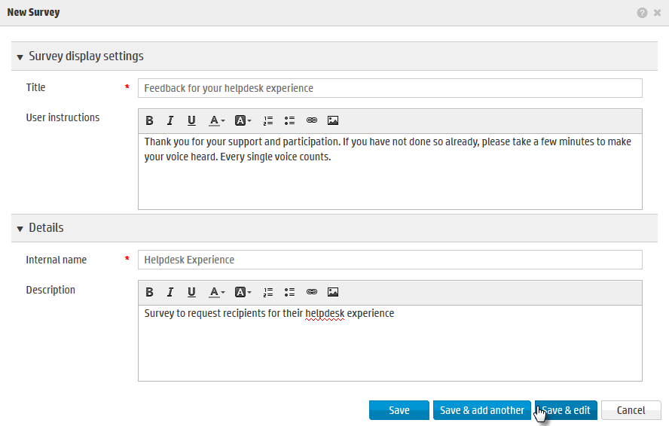
Create a new Survey (2)
From the Survey List, click New.
Enter the Title, User instructions, Internal name and click Save and edit.

Slide 12
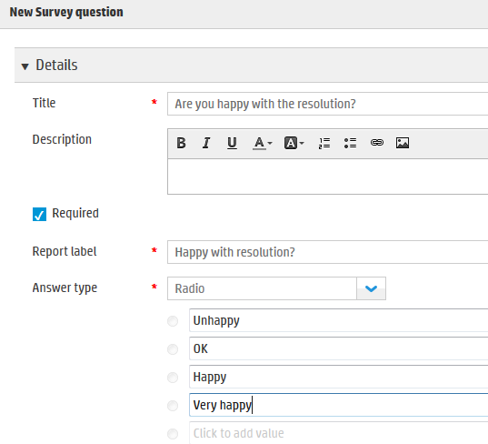
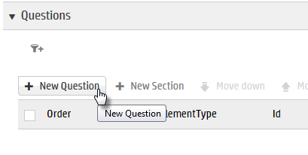
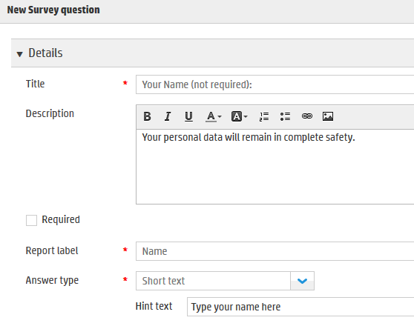
Create a new Survey (3)
From the Survey List, click New.
Enter the Title, User instructions, Internal name and click Save and edit.
Add Questions to the survey.

Slide 13
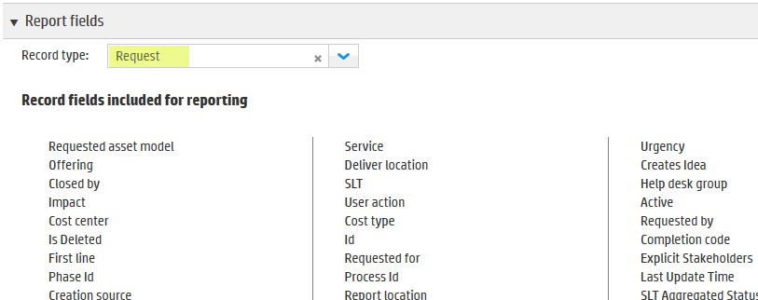
Create a new Survey (4)
From the Survey List, click New.
Enter the Title, User instructions, Internal name and click Save and edit.
Add Questions to the survey.
Set a Record type to have survey related to this record type and select reporting fields.
Relating a survey to a record type is not mandatory

Slide 14
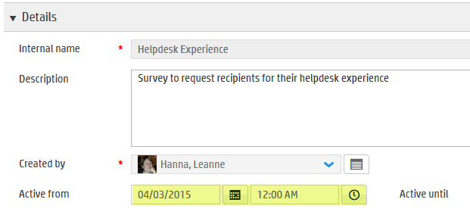
Create a new Survey (5)
From the Survey List, click New.
Enter the Title, User instructions, Internal name and click Save and edit.
Add Questions to the survey.
Set a Record type to have survey related to this record type and select reporting fields.
Schedule the survey by setting the Active from and Active until fields.

Slide 15
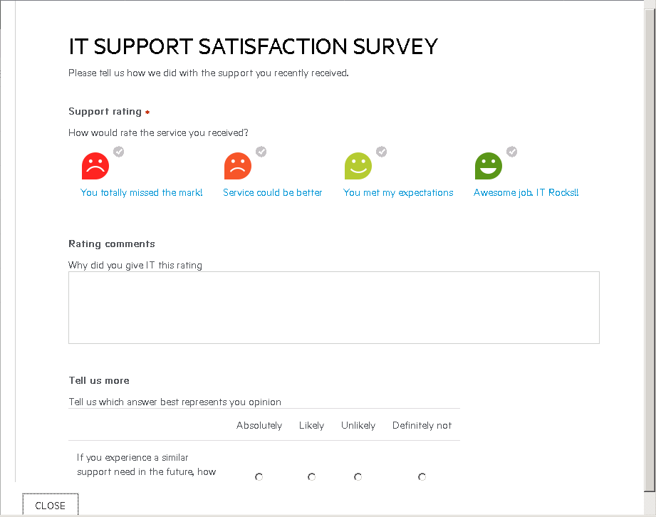
Create a new Survey (6)
From the Survey List, click New.
Enter the Title, User instructions, Internal name and click Save and edit.
Add Questions to the survey.
Set a Record type to have survey related to this record type and select reporting fields.
Schedule the survey by setting the Active from and Active until fields.
Preview the survey

Slide 16


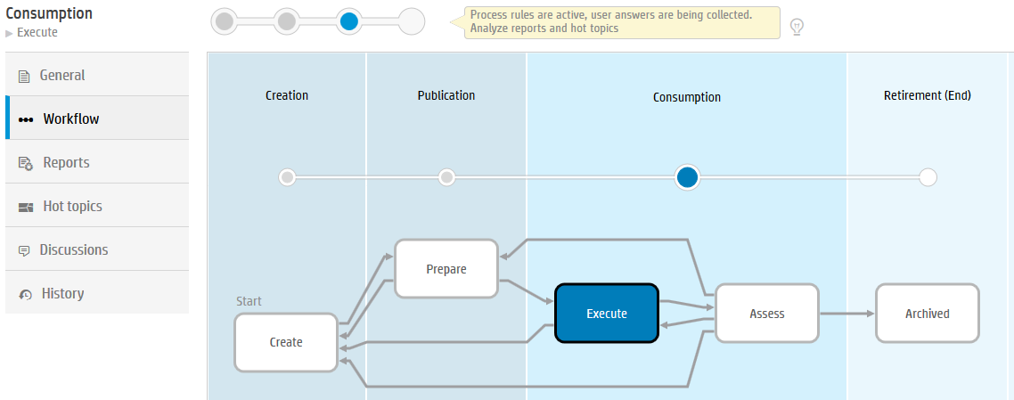
Create a new Survey (7)
The survey is now active
Execute the survey.
Notes:
For further information about creating a new survey, please refer to the Help Center.

Slide 17
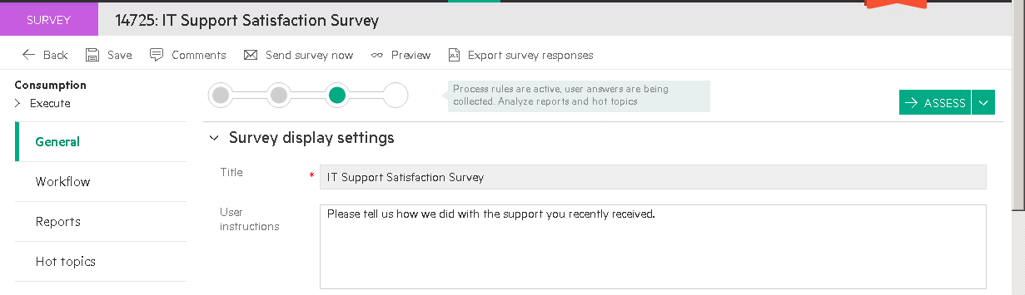
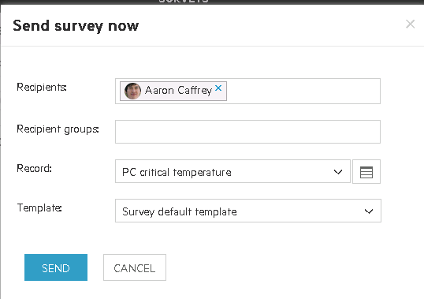
Send a Survey Manually

Slide 18
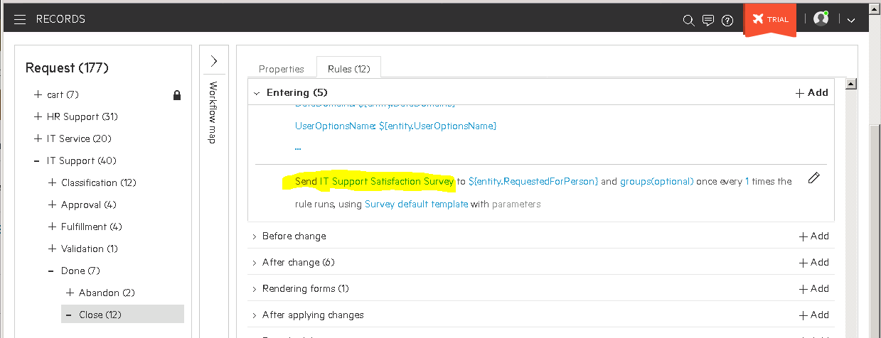
Automatically Send a Survey using a Business Rule

Slide 19

Lab Exercise
EX11.0 Using Survey Management

